Slide 1
VMware by Broadcom Solution
VMware Cloud Foundation Operations Knowledge Transfer Workshop

Slide 2
Useful Links for PSO Consultant (VCF 5.x)
Delete or Hide this slide when presenting to the Customer
Aria (top-level)
https://vmw-confluence.broadcom.net/display/VCFGTM/VMware+Aria
https://sales-resources.broadcom.com/group/vcf/vcf-operations
VMware Cloud Foundations Operations Resources
Key Resources and Sales Assets
https://vmw-confluence.broadcom.net/pages/viewpage.action?spaceKey=VCFGTM&title=Aria+Operations -
https://vmw-confluence.broadcom.net/pages/viewpage.action?spaceKey=VCFGTM&title=Aria+Operations -
Technical Resources
https://vmw-confluence.broadcom.net/pages/viewpage.action?spaceKey=VCFGTM&title=Aria+Operations
Customer References and Wins
https://vmw-confluence.broadcom.net/pages/viewpage.action?spaceKey=VCFGTM&title=Aria+Operations
CMBU Demo Lab
https://docs.google.com/document/d/1AU8YYCXg_Ayg3wnyweW07DfQfaFgjApdybDd-YdauuI/edit
VMware Cloud Foundations Operations Technical Documentation
https://techdocs.broadcom.com/us/en/vmware-cis/aria.html
Hands on Labs
https://labs.hol.vmware.com/HOL/catalog
NOTE TO PSO Consultant/Architect:
There is no prescribed knowledge transfer deck for this microservice. Please leverage the materials available for the VMware technical marketing team using the links to the left.
Recommended workshop topics appear after this slide, if available. These should be adapted for the Customer as needed.

Slide 3
Useful Links for PSO Consultant (VCF 9.x)
Delete or Hide this slide when presenting to the Customer
VCF Operations Resources (Sales, Technical, and Demos)
https://sales-resources.broadcom.com/group/vcf/vcf-operations
VMware Cloud Foundations Operations Technical Documentation
https://techdocs.broadcom.com/us/en/vmware-cis/vcf/vcf-9-0-and-later/9-0.html
Hands on Labs
https://labs.hol.vmware.com/HOL/catalog
NOTE TO PSO Consultant/Architect:
There is no prescribed knowledge transfer deck for this microservice. Please leverage the materials available for the VMware technical marketing team using the links to the left.
Recommended workshop topics appear after this slide, if available. These should be adapted for the Customer as needed.

Slide 4
Introductions and Workshop Objectives
Conceptual Design
Solution Scope
Logical Design
VMware Cloud Foundation Operations Design Session
Next Steps

Slide 5
Introductions and Workshop Objectives
Participant introductions
What experience do you have?
Why are you attending this workshop?
What do you expect to achieve?
Expectations of the workshop
Outcomes expected of workshop
PS Consultant: Please fill out these bullet points to provide scope and expectations of this workshop.

Slide 6
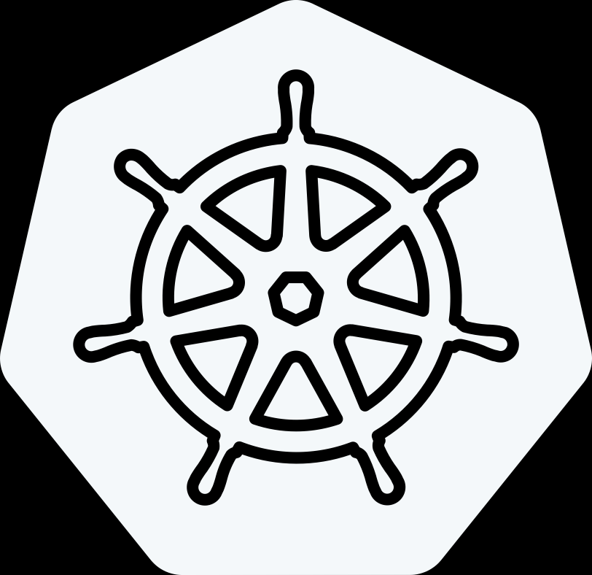
Delivering the Modern Private Cloud
VCF Advanced Services
Cyber Compliance
Advanced
Security
Load Balancing
Data Services
Application Services
Network
Observability
Business Operations
Identity Security
VMware Cloud Foundation 9
Modern Cloud Interface
Tenant Management, Content
Service Catalog, Orchestration, Applications
Private AI
Traditional VMs
K8s
Automation & Operations
Capacity, Configuration, Tenancy
SRE Ops, Fleet & Security Management,
Compute
Storage
Networking
On-Premises
Public Cloud
Sovereign Cloud
Edge
Telco
The information in this presentation is for informational purposes only and may not be incorporated
into any contract. There is no commitment or obligation to deliver any items presented herein.
Notes:
Talk Track:
Let's introduce VMware Cloud Foundation (VCF) 9 and the advanced services that are available with VCF.
VCF offers a flexible platform that can be deployed on-premises, in public clouds, within sovereign clouds, at the edge, or even in telco environments. This extensible approach allows VCF to support both traditional and modern application environments, enabling a wide range of deployment scenarios. One key feature of VCF is license portability, which we’ll explore in more detail later. This feature allows customers to take entitlements purchased on-premises and extend them across various environments, including public cloud providers, hyperscalers, sovereign clouds, edge locations, and telco environments.
When we talk about the personas that interact with VCF 9, we typically focus on two main groups: the cloud admins (formerly referred to as VI admins) and the consumers of the infrastructure. Cloud admins are responsible for deploying and managing the infrastructure from the ground up. This includes setting up the initial environment (Day 0), managing capacity, and ensuring proper configuration and tenancy for different consumers within the system.
Cloud admins are also focused on site reliability engineering, ensuring operational efficiencies are in place to scale effectively. They manage the underlying infrastructure for compute, storage, and networking, utilizing core VMware technologies like vSphere, vSAN, and NSX, as well as other networking technologies. All of this is integrated through an operational layer that provides fleet management, security, and automation, allowing the cloud admin to deliver a private cloud platform as a service. This infrastructure supports traditional VM-based applications, Kubernetes for container orchestration, and even AI and machine learning environments, including generative AI.
On the other side, consumers leverage the infrastructure-as-a-service (IaaS) components, which are abstracted for compute, storage, and networking. These services provide a framework for developers, platform teams, and DevOps teams to use IaaS and deploy multi-tenant environments. The platform manager oversees tenant management, ensuring everything is organized within a self-service catalog. This allows users to blueprint standardized models for deploying new applications, which include security, networking, storage, and compute requirements—such as GPU allocation. Once these models are configured, they can be easily deployed each time a consumer needs to build a new application cluster.
This setup also includes orchestration tools and application services necessary for a complete developer environment. Much of this is powered by the embedded Kubernetes runtime (VKE), the vSphere Kubernetes service, and associated services, which combine IaaS components with the other elements required to deliver a modern application environment. Together, cloud admins and consumers leverage VCF as a private cloud platform to deliver these services at scale.
Beyond the core VCF platform, VMware also offers a portfolio of advanced services to cover key use cases like private AI, disaster recovery, ransomware protection, advanced security (including cybersecurity measures for malware and ransomware), load balancing, application services, data services (such as database-as-a-service), network observability, business operations, and secure access. We’ll dive deeper into these advanced services in a future module.
Consumers can access these services through their preferred language, whether it's APIs, CLIs, or infrastructure-as-code, providing a flexible and scalable platform that meets a variety of needs.

Slide 7
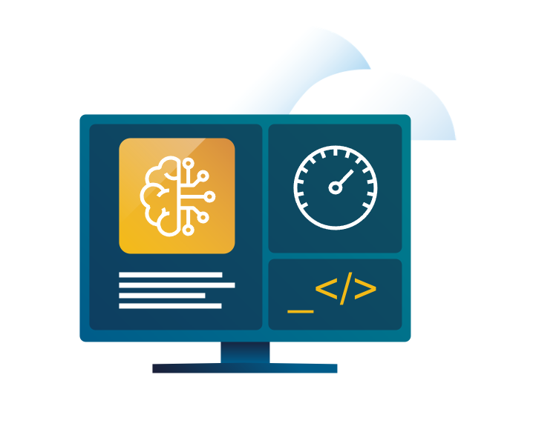
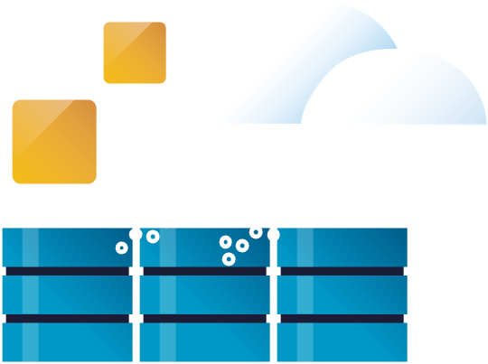
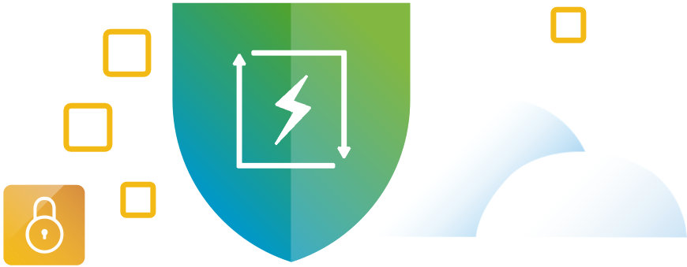







9 Common Use Cases for Private Cloud
Infrastructure Modernization
Application Modernization
Security Modernization
Build and deploy private cloud infrastructure on-premises
Enable self-service infrastructure and cloud services for app teams.
Strengthen compliance and harden infrastructure
Optimize infrastructure and operations
Build, run and manage Kubernetes and other modern workloads
Bolster lateral security and intrusions prevention/ detection
Extend data center to the Edge, public and sovereign clouds
Build, run and manage Private AI apps
Accelerate recovery from ransomware and other disasters
Notes:
Now that we’ve covered what VMware Cloud Foundation delivers, let’s look at how customers are putting it to work.
These nine use cases reflect real-world priorities we’re seeing across industries — and they map directly to the three pillars we’ve been discussing.
Under Modern Infrastructure, customers are building private cloud platforms to replace aging three-tier infrastructure — modernizing their core data centers with automated provisioning and full-stack lifecycle management.
Others are extending their private cloud out to edge locations, like retail stores and manufacturing facilities, where they need cloud services close to users and devices.
And many are delivering Infrastructure as a Service internally — providing dev teams or business units with on-demand access to compute, storage, and network resources without manual IT bottlenecks.
Under the Unified Cloud Experience pillar, organizations are accelerating application modernization by running Kubernetes clusters alongside VMs
We’re also seeing customers enabling Private AI — deploying NVIDIA GPUs on VCF to support AI model training and inferencing, all within their secure private cloud environment.
And they’re using DevOps principles like infrastructure as code to drive faster innovation across development and operations teams.
And finally, when it comes to a Secure and Resilient Platform, VCF helps organizations deliver ransomware protection by leveraging automated backup and recovery solutions integrated into the stack.
They’re deploying disaster recovery as a service between sites using VMware tools like VMware Live Recovery which is an advanced service for VCF.
And they’re ensuring continuous compliance for industries like finance and healthcare by embedding security policies at the infrastructure level.
These examples highlight how VCF helps organizations build modern infrastructure, create a seamless cloud experience across environments, and strengthen their security and resilience at every layer.

Slide 8
Solution Scope
The table below lists the scope of the engagement in the context of the VMware journey model. These are the IT Capabilities that have been determined as the focus for this engagement
IT Capabilities in Scope
Provide resiliency for business applications
Monitor and manage infrastructure performance and capacity

Slide 9
Solution Scope
The table below lists the scope of the engagement in the context of the VMware journey model. These are the IT Problems that have been determined as the focus for this engagement
IT Problems in Scope
Business critical failures lead to unplanned downtime
Not meeting availability service level agreement
Infrastructure performance problems
Unplanned workload failures
Vendor lock-in and business application complexity
Infrastructure capacity problems

Slide 10
VMware Solution
Logical Diagram
PSO Consultant: Insert appropriate logical diagrams based on the current solution. Review the diagram, covering each component and its function

Slide 11
Engagement Scope - Technical
This specific engagement by VMware Professional Services included the following components of the VMware Solution. This Solution Design content will only refer to these components.
Technology Components | Version
VMware Cloud Foundation Operations | 9.0

Slide 12
Engagement Scope - People and Process
This specific engagement by VMware Professional Services included the following components of the VMware Solution. This Solution Design content will only refer to these components.
People and Process Components

Slide 13
VMware Cloud Foundation Operations
Deploy VMware Cloud Foundation Operations

Slide 14
Product Resources
Product Capabilities
Deployment Review
Deployment Walkthrough
Adoption Activities

Slide 15
Product Resources

Slide 16
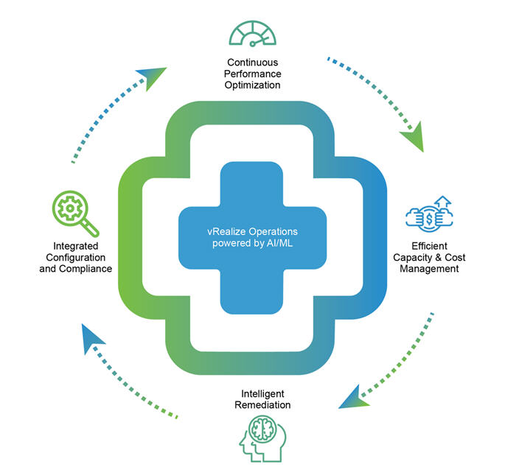
Product Resources
Where to find product information
VMware Documentation
All products: https://techdocs.broadcom.com/
VMware Aria Operations (5.x): https://techdocs.broadcom.com/us/en/vmware-cis/aria/aria-operations/8-18.html
VMware Cloud Foundation Operations (9.x): https://techdocs.broadcom.com/us/en/vmware-cis/vcf/vcf-9-0-and-later/9-0/infrastructure-operations.html

Slide 17
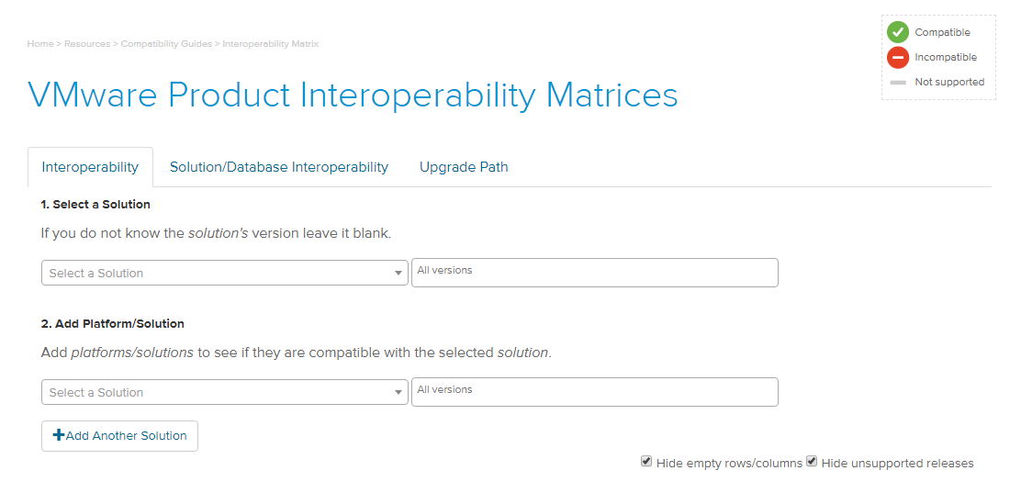
Product Resources
Where to find product information
VMware Product Interoperability
Validate VMware Product Interoperability: https://interopmatrix.broadcom.com/Interoperability

Slide 18
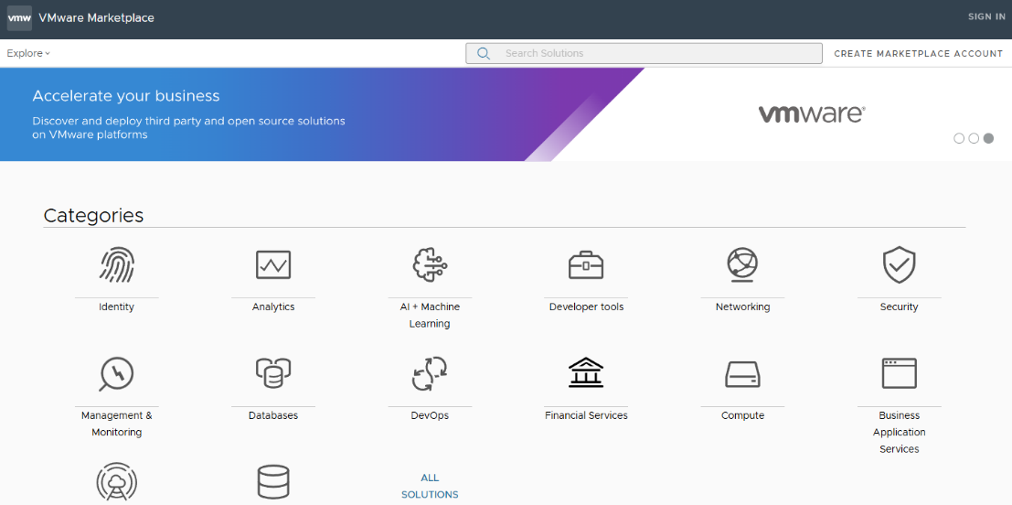
Product Resources
Where to find management pack information
VMware Marketplace: https://vcf.broadcom.com/vsc/
VMware Management Packs
3rd party Management Packs
Product Capabilities

Slide 19
Product Capabilities

Slide 20
Product Capabilities
NOTE TO PSO Consultant/Architect:
Insert slides from the technical marketing decks here to tailor the presentation to the Customer.

Slide 21
Configuration Review

Slide 22
Configuration Review
NOTE TO PSO Consultant/Architect:
In this section, summarize the customer pain points and goals captured during the Solution Design Workshops. Use information captured in the Requirements Traceability Matrix as well as in the final design decisions captured in the Solution Design document to build a tailored version of this ppt. Leverage screen shots as needed.

Slide 23
Configuration Walkthrough

Slide 24
Configuration Walkthrough
NOTE TO PSO Consultant/Architect:
In this section, demonstrate the configuration performed.

Slide 25
Adoption Activities
NOTE TO PSO Consultant/Architect:
This section is intended to be a high-level review of the capabilities of VMware Cloud Foundations Operations. Given the use case focused nature of this microservice, you may not have time to perform this product review but try to present this section. The hope it the review may open the Customer’s eyes to other ways to realize value outside of the original use case.
Use the following slides as a template for the discussion of the Customer’s pain points as well as to understand the current state of the Customer’s monitoring environment and capabilities.
Review the capabilities of VMware Cloud Foundations Operations. The slides are aligned to the public marketing messaging. Ideally, the VMware Cloud Foundations Operations uses are presented in each slide and then demonstrated live on an instance of the product or in a demo environment.
You may also customize this section to provide adoption activities specific to the use case configuration performed.

Slide 26
Current State
Customer Pain Points
Performance
Capacity management and planning
Root Cause Analysis
Compliance
Costing

Slide 27
Current State
Monitoring Solutions
Virtual infrastructure
Storage infrastructure
Syslog and event logging

Slide 28
VMware Cloud Foundations Operations
Use Cases
Continuous Performance Optimization
Capacity and Cost Management and Planning
Integrated Compliance
Intelligent Remediation
vSphere security and compliance monitoring
Next-Gen Ops Platform

Slide 29
VMware Cloud Foundations Operations
Continuous Performance Optimization
Automated workload balancing
Continuous and automated workload placement throughout the VM lifecycle
Continuous Performance Optimization
Automated workload balancing
Predictive DRS

Slide 30
VMware Cloud Foundations Operations
Capacity and Cost Management and Planning
Proactive capacity management
Reclaim and right-size
VMware Cloud cost management
Capacity planning

Slide 31
VMware Cloud Foundations Operations
Integrated Compliance
VMware Cloud configuration & compliance
VMware Cloud regulatory compliance
Automated configuration management

Slide 32
VMware Cloud Foundations Operations
Intelligent Remediation
Troubleshooting workbench
Unified visibility across VMware Cloud and native public clouds
360-degree troubleshooting
Native VMware Cloud integrations
Global operations for vSAN

